Slide 2
Loop Statements
In programming, sometimes we need to execute the block of code repeatedly while some condition evaluates to true.
However, loop statements are used to execute the set of instructions in a repeated order.
In Java, we have three types of loops that execute similarly. However, there are differences in their syntax and condition checking time.
for loop
while loop
do-while loop

Slide 3
Java for loop
It enables us to initialize the loop variable, check the condition, and increment/decrement in a single line of code.
We use the for loop only when we exactly know the number of times, we want to execute the block of code.
for(initialization, condition, increment/decrement) {
//block of statements
}

Slide 4
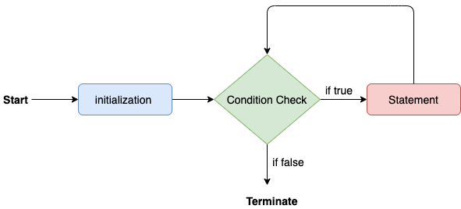
The flow chart for the for-loop is given below

Slide 5
public class Calculattion {
public static void main(String[] args) {
for(int j = 1; j<=10; j++)
{
System.out.println(“j = “+ j); }
}
}

Slide 6
public class Calculattion {
public static void main(String[] args) {
int sum = 0;
for(int j = 1; j<=10; j++) {
sum = sum + j;
}
System.out.println("The sum of first 10 natural numbers is " + sum);
}
}

Slide 7
Usecase 1: Providing expression in for loop is a must
For loop must consist of a valid expression in the loop statement failing which can lead to an infinite loop. The statement
for ( ; ; )

Slide 8
// Java program to illustrate Infinite For loop
// Main class
public class Test {
// Main driver method
public static void main(String[] args)
{
// For loop
for (;;) {
System.out.println("This is an infinite loop");
}
}
}

Slide 9
Usecase 2: Initializing Multiple Variables
In Java, multiple variables can be initialized in the initialization block of for loop regardless of whether you use it in the loop or not.

Slide 10
public class Test {
// Main driver method
public static void main(String[] args)
{
// Declaring an integer variable
int x = 2;
// For loop to iterate
for (long y = 0, z = 4; x < 10 && y < 10;
x++, y++) {
System.out.println(y + " ");
}
// Printing value/s stored in variable named x
// defined outside body of for loop
System.out.println(x);
}
}
Output0 1 2 3 4 5 6 7 10

Slide 11
Predict the Output of the following Programs
class dkl
{
public static void main(String args[])
{
int i;
for(i = -1;i<10;i++)
{
System.out.println(++i);
}
}
}
Output
0
2
4
6
8
10

Slide 12
class dk3
{
public static void main(String args[])
{
int m=2,n=15;
for(int i=1;i<=5;i++)
{
m++;--n;
System.out.println("m="+m);
System.out.println("n="+n);
}
}
}

Slide 13
Output
m=3
n=14
m=4
n=13
m=5
n=12
m=6
n=11
m=7
n=10

Slide 14
Factorial
public class Factorial {
public static void main(String[] args) {
int num = 10;
long factorial = 1;
for(int i = 1; i <= num; ++i)
{
// factorial = factorial * i;
factorial *= i;
}
System.out.printf("Factorial of %d = %d", num, factorial);
}
}

Slide 15
Java While Loop
The while loop loops through a block of code as long as a specified condition is true:
Syntax:
Initialization;
while (test_expression)
{
// statements
update_expression;
}

Slide 16
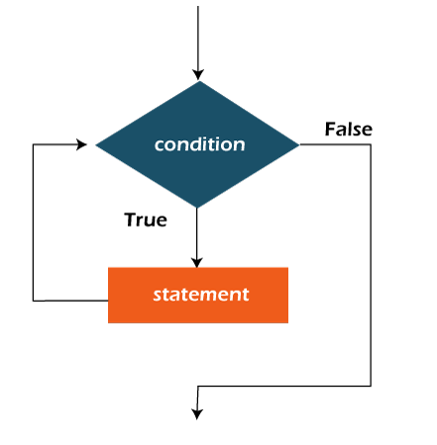

Slide 17
class whileLoopDemo {
public static void main(String args[])
{
// initialization expression
int i = 1;
// test expression
while (i < 6) {
System.out.println("Hello World");
// update expression
i++;
}
}
}

Slide 18
Example 2: This program will find the summation of numbers from 1 to 10.
class whileLoopDemo {
public static void main(String args[])
{
int x = 1, sum = 0;
// Exit when x becomes greater than 4
while (x <= 10) {
sum = sum + x;
x++;
}
System.out.println("Summation: " + sum);
}
}

Slide 19
//Fibonacci Series
class Main {
public static void main(String[] args) {
int i = 1, n = 10, firstTerm = 0, secondTerm = 1;
System.out.println("Fibonacci Series till " + n + " terms:");
while (i <= n) {
System.out.print(firstTerm + ", ");
int nextTerm = firstTerm + secondTerm;
firstTerm = secondTerm;
secondTerm = nextTerm;
i++;
}
}
}

Slide 20
# sum of digits of given number
public class Main
{
public static void main (String[]args)
{
int num = 12345, sum = 0;
//loop to find sum of digits
while(num!=0){
sum += num % 10;
num = num / 10;
}
System.out.println ("Sum of digits : " + sum);
}
}

Slide 21
Example 1: Reverse a Number using a while loop in Java
class Main {
public static void main(String[] args) {
int num = 1234, reversed = 0;
System.out.println("Original Number: " + num);
// run loop until num becomes 0
while(num != 0) {
// get last digit from num
int digit = num % 10;
reversed = reversed * 10 + digit;
// remove the last digit from num
num /= 10;
}
System.out.println("Reversed Number: " + reversed);
}
}

Slide 22
Break
The break statement in java is used to terminate from the loop immediately.
When a break statement is encountered inside a loop, the loop iteration stops there, and control returns from the loop immediately to the first statement after the loop

Slide 23
// Java program to demonstrate using
// break to exit a loop
class BreakEx {
public static void main(String[] args)
{
for (int i = 0; i < 10; i++) {
if (i == 5)
break;
System.out.println("i: " + i);
}
System.out.println("Out of Loop");
}
}

Slide 24
Continue Example
The continue statement breaks one iteration (in the loop), if a specified condition occurs, and continues with the next iteration in the loop.
int i = 0;
while (i < 10) {
if (i == 4) {
i++;
continue;
}
System.out.println(i);
i++;
}

Slide 25
// Demonstrate continue.
class Continue {
public static void main(String args[]) {
for(int i=0; i<10; i++) {
System.out.print(i + " ");
if (i%2 == 0) continue;
System.out.println("");
}
}
}

Slide 26
// Using continue with a label.
class ContinueLabel {
public static void main(String args[]) {
outer: for (int i=0; i<10; i++) {
for(int j=0; j<10; j++) {
if(j > i) {
System.out.println();
continue outer;
}
System.out.print(" " + (i * j));
}
}
System.out.println();
}
}

Slide 27
